Slide 1

Welcome Everyone!
Welcome Everyone!
Agency
Self-Assessment
of Internal Controls
Overview
State of Kansas
Internal Control & Compliance
Statewide Consolidated Reporting, Controls, & Collections Team
Notes:
(Intro Slide)
******(BEFORE YOU BEGIN: OPEN (1)The Internal Control Video (2)GAO Greenbook flyer (3)COSO Website}*****
Welcome Everyone to our presentation today on the State of Kansas Agency Self-Assessment of Internal Controls.
We will be recording our session today so we ask that you turn your video and microphones off to minimize distractions. This video will be posted for future viewing for those who are not able to attend.
My name is Gina Stanley and I am the Internal Control Data Analyst in the Department of Administration, Office of Accounts and Reports. I thought it would be nice to put a face to the voice you will be hearing during our presentation before I turn my video off for the remainder of the presentation. (TURN VIDEO OFF)
Before we get started, we would like you to know that if you have any questions during this presentation, please feel free to drop your questions in the chat box. We have someone who will be moderating and answering questions during and at the end of our session today.
We would like to make some acknowledgments as well as introduce our Team before we get started. (Next Slide)

Slide 2
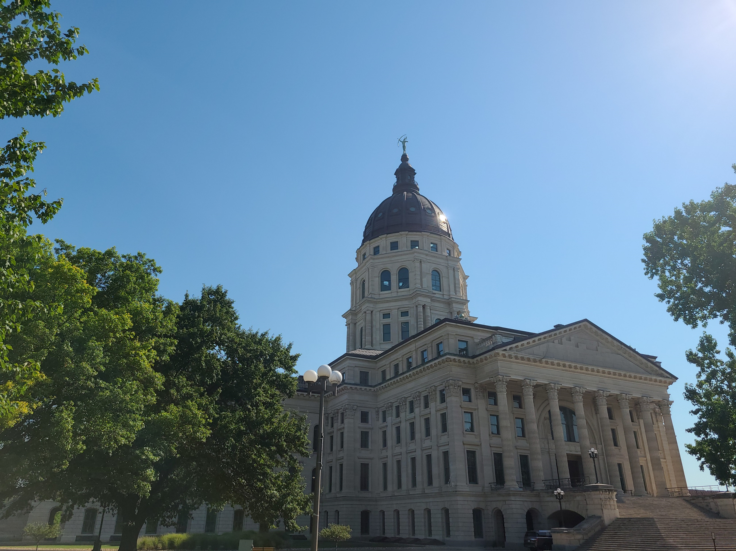

Acknowledgements
The Kansas Department of Administration, Office of Accounts & Reports would like to credit the following organizations:
GAO – The United States Government Accountability Office
COSO –The Committee of Sponsoring Organizations of the Treadway Commission

Slide 3
Nancy Ruoff
Director
Sunni Zentner
SPA Dep Dir.
Stacy Jaramillo
SAAMS Dep Dir.
Brandy Wilson
SCRCC Dep Dir.
Statewide
Payroll
Statewide Accounting
Audit
Services
Municipal
Services
Federal Reporting
Financial
Integrity
Central Responsibilities
State Revolving Fund
Setoff & KTOP
Internal
Controls

Slide 4
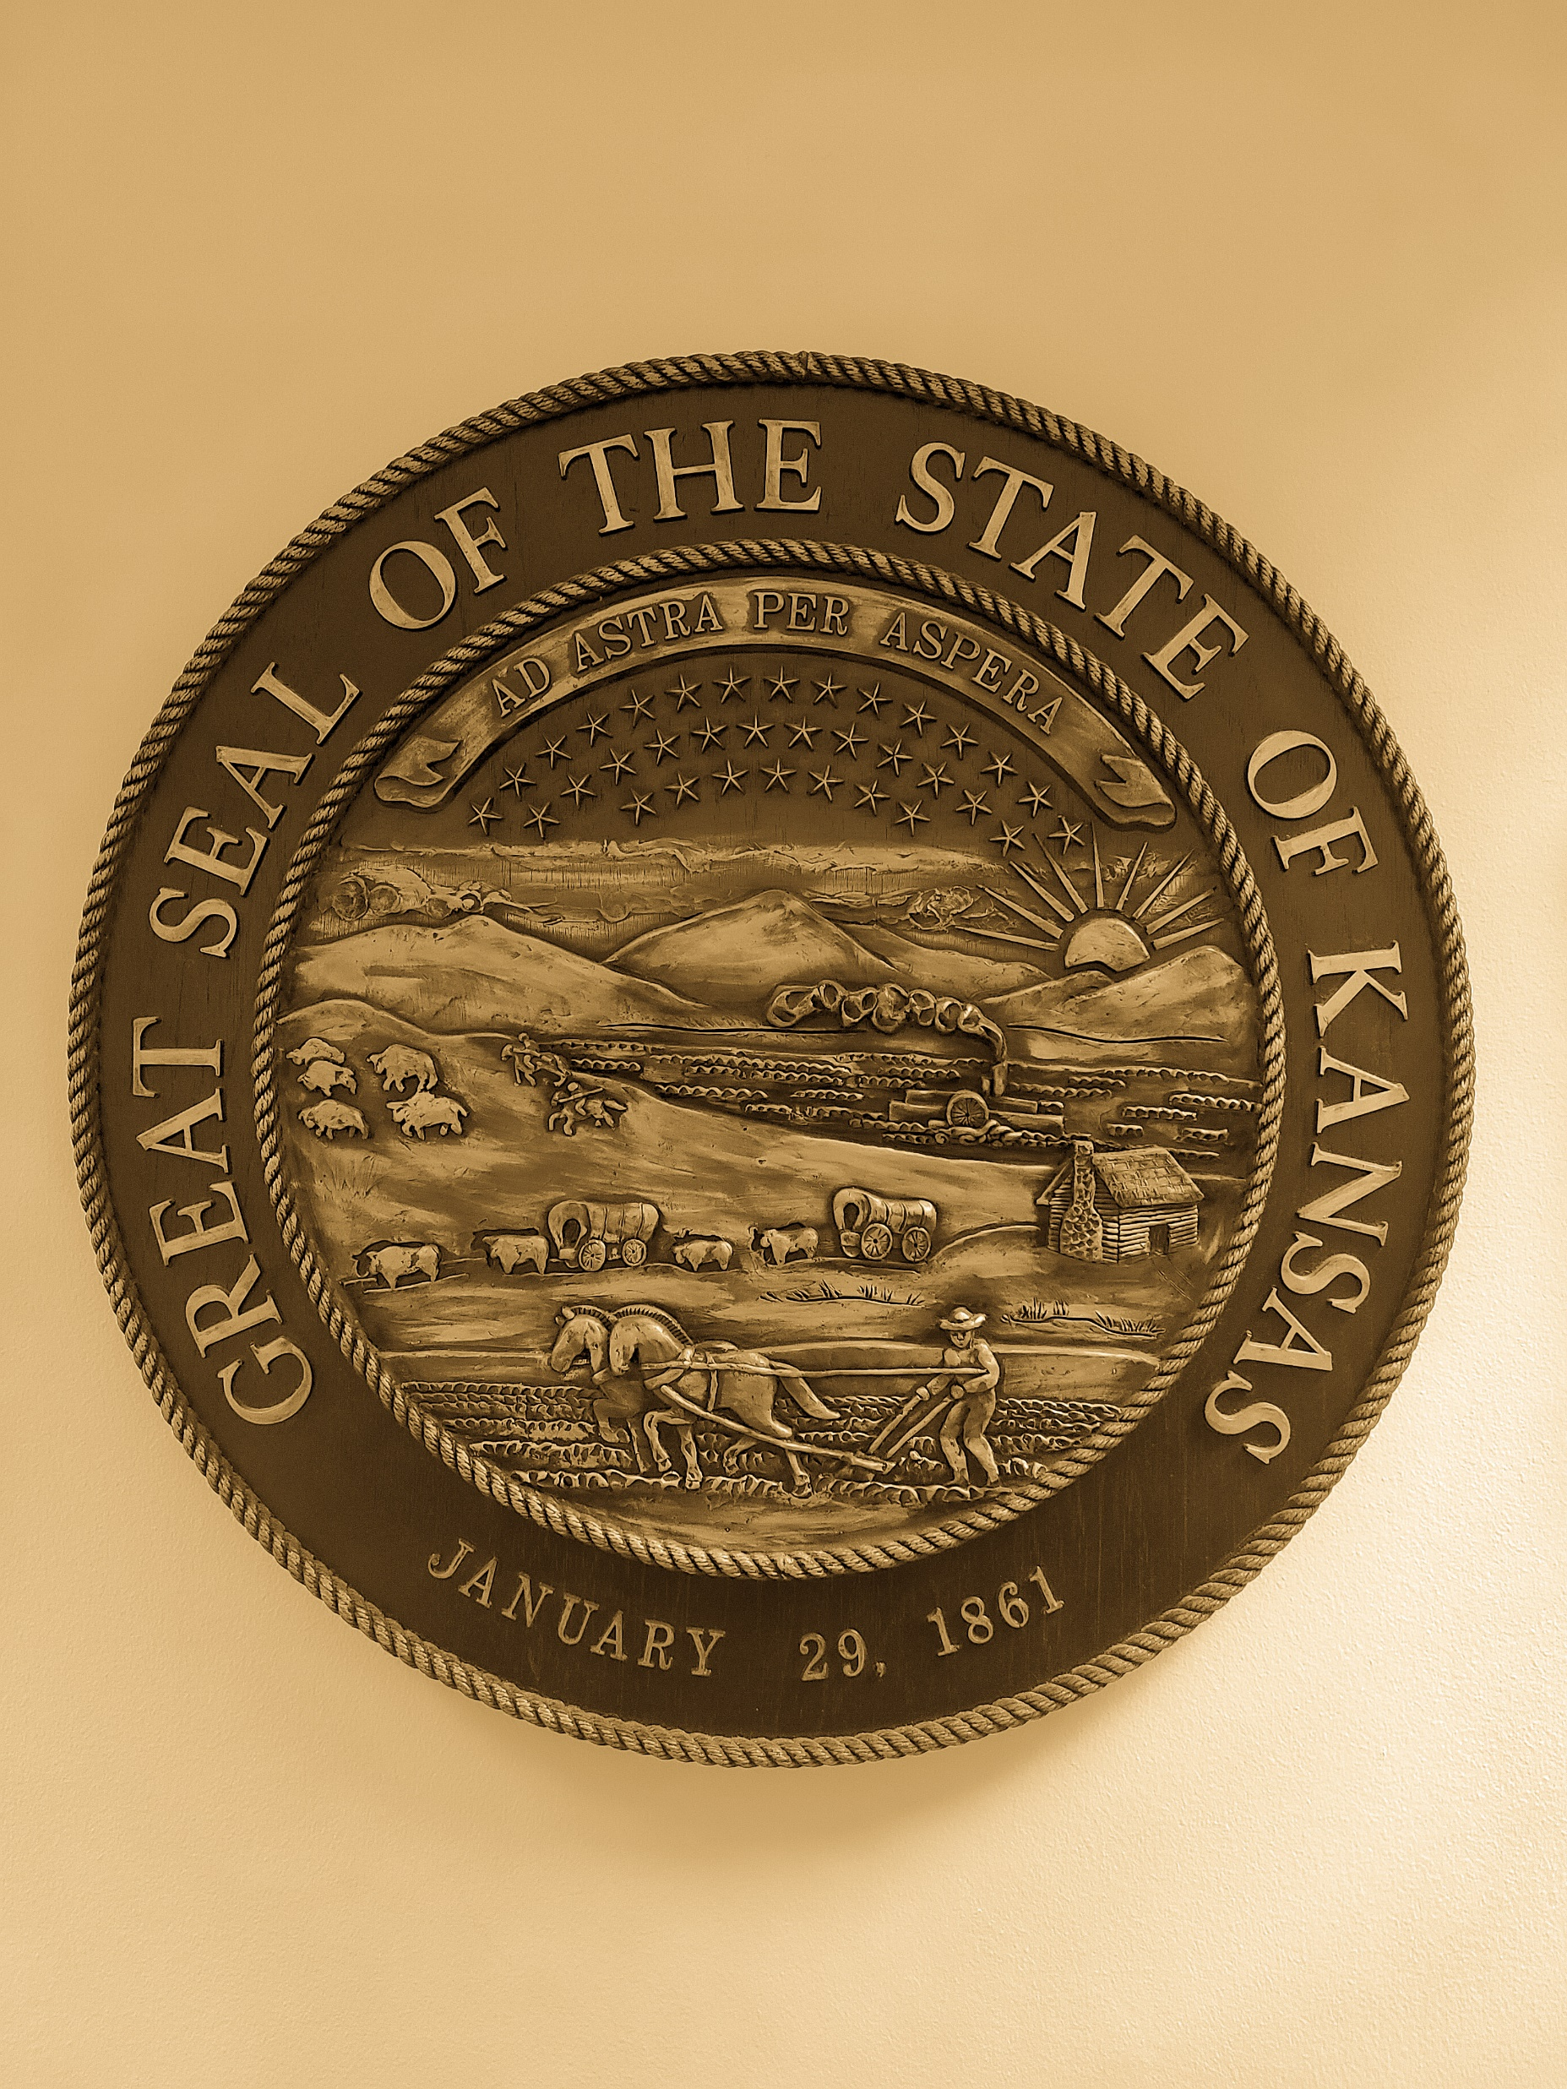
Questions to Answer
Who will be involved?
Why is the State of Kansas doing this?
How will this be accomplished?
What are Internal Control Components?
What are we doing?
When is the deadline for this part of the process?
Where is this to be completed?

Slide 5
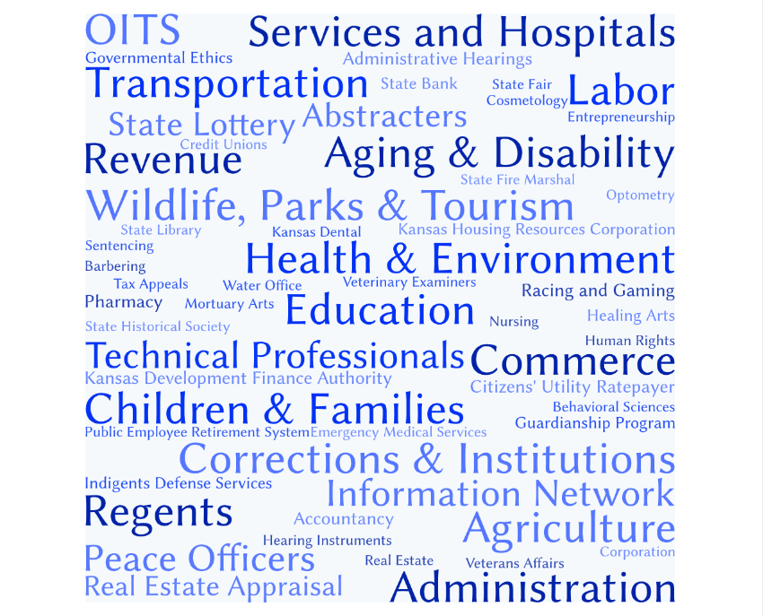

Slide 6

The Why
Governed by the U.S. GAO Green Book
  Improves performance
  Ensures transparency
  Saves money
In cooperation with COSO
  Guidance on Prevention of
  Fraud or Abuse of Public Trust
  & works with federal agencies
  Five Accounting/Auditing Organizations
Internal Controls Video
Organizations
IC

Slide 7


Internal Control
Internal Control Overview
is a process integrating the activities, plans, attitudes, policies, & efforts of the people of a department working together to provide reasonable assurance that the department will achieve its objectives in the following categories:
Operations
Effectiveness & efficiency of operations, including operational & financial performance goals, & safeguarding assets against loss
Compliance
Reporting
Adherence to applicable laws & regulations
Reliable & timely internal & external financial & non-financial reporting

Slide 8
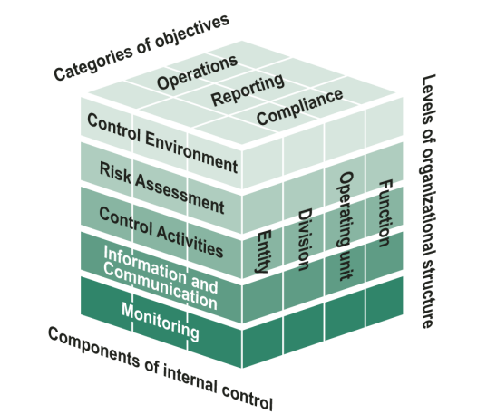
The How
Internal Control Framework Cube
Broken down by
Categories of Objectives
Levels of Organizational Structure
Components of Internal Control
Sources: COSO and GAO. | GAO-14-704G

Slide 9
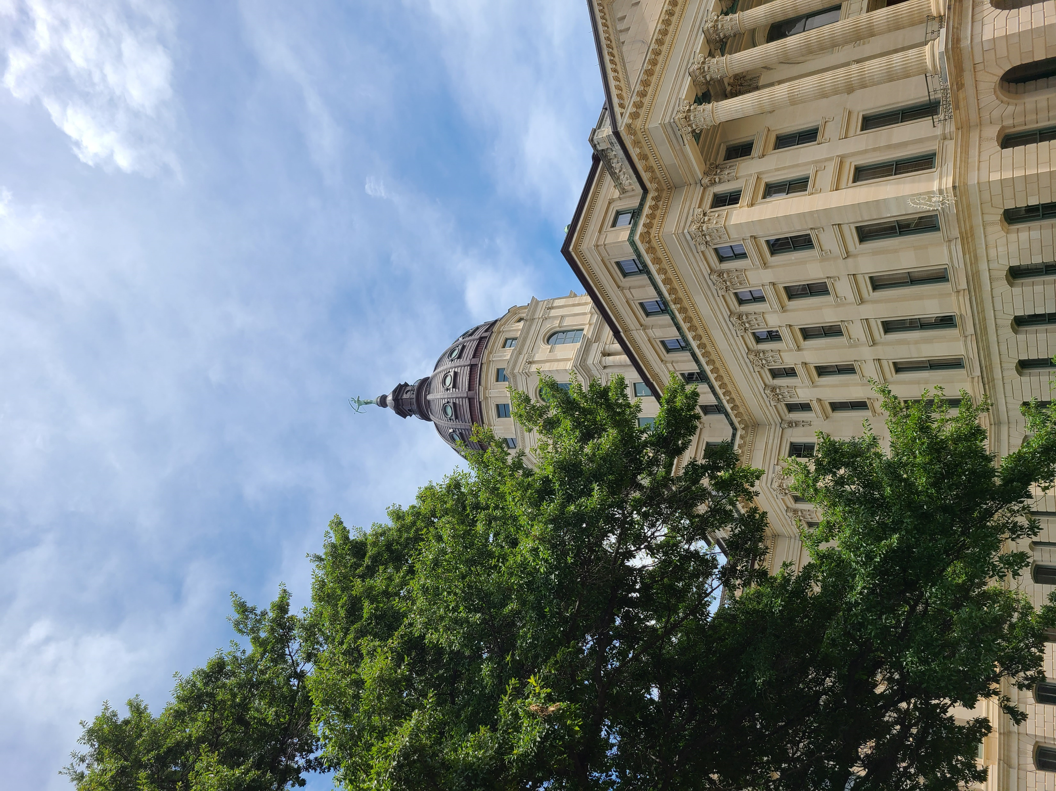

What are the
Internal Control
Components?
Control Environment
Risk Assessment
Control Activities
Information & Communication
Monitoring Activities
COSO Framework Cube

Slide 10

Fundamental Concepts of Internal Control
Departmental Objectives affecting its people, processes, & infrastructure
People-dependent actions, attention, & attitudes
Cost-effective & adaptable operating environment(s)
Processes consisting of ongoing tasks & activities
Reasonable not absolute assurance regarding the achievement of objectives

Slide 11
Control Environment
Management Philosophy & Operating Style
Assignment of Authority & Responsibility
Commitment to Competence
Organizational Structure
Tone at the Top
Integrity & Values
HR Policies & Practices

Slide 12
Risk Assessment
Identify
Change to Internal & External Conditions
Fraud
*Types
*Factors
*Response
Identify,
Analyze,
& Respond
to Risks
Analyze & Respond Through Risk Assessment
Assess Risk Tolerances & Responses & Change Internal Controls
Based on Objectives &
Defining Risk Tolerances
Assessment

Slide 13
Control Activities
Segregate Control Activities at
Risk in Each Duty
Design the IS
& the IT Infrastructure
Design
Control Activities at Various Levels
& Review
Design the
IT Acquisition, Development, & Maintenance
Activities
Document Responsibilities Through
Policies
Response to Objectives & Risks

Slide 14
Information and Communication
External Communication
for Effective
Oversight
of Internal
Control
Data Processed into Quality Internal Control Information
Use
Appropriate Methods of Communication Internally & Externally
Quality Info.
is Shared at all Levels & with all Reporting Lines
Internal & External
Consider
Communication Factors: Audience, Nature of Info., Availability, Cost, Legal Req.
Internal Communication Throughout the Entity

Slide 15
Monitoring
Evaluation
of Results of Ongoing Monitoring & Separate
Evaluations
Separate Evaluations
from Internal & External Reviewers
Internal
Control Issue
are Reported & Evaluated Internally & Possibly Externally
Ongoing Monitoring of Operating Effectiveness
Evaluate
Timely
Corrective
Actions Resolve Internal Control Deficiencies
Establish a Baseline for Internal
Control

Slide 16






Principles of the Internal Control Framework
Control
Environment
Risk
Assessment
Control
Activities
Information & Communication
Monitoring
Demonstrate Commitment to Integrity & Ethical Values
Exercise Oversight Responsibility
Establish Structure, Responsibility, & Authority
Demonstrate Commitment to Competence
Enforce Accountability
Define Objectives & Risk Tolerances
Identify, Analyze, & Respond to Risks
Assess Fraud Risk
Identify, Analyze, & Respond to Change
Design Control Activities
Design Activities for Information System
Implement Control Activities
Use Quality Information
Communicate Internally
Communicate Externally
Perform Monitoring Activities
Evaluate Issues & Remediate Deficiencies

Slide 17
What are we Doing?
Evaluating
Step One…
Agency Self-Assessment of Internal
Controls
Operations
Compliance
IC
Reporting

Slide 18
Objectives Through Internal Control
Assessment – 140 questions
One Assessment per Agency
Recommendations:
Identify appropriate team of staff
Complete the entire assessment in one session
Open-ended internal agency conversations

Slide 19
Objectives Through Internal Control
Link will be sent in the next few days
Risk Ratings & Response
Agency staff discuss and implement
improvement to internal control

Slide 20
Sections of the Assessment
Procurement & Accounts Payable
Purchasing, Invoice Processing, Petty Cash, & Employee Payroll & Expenses
General Elements of Internal Control
Control Environment, Risk Assessment, Control Activities, Communication & Information Systems, & Monitoring
Budgeting
Accounts Receivable & Cash Receipts
Accounts Receivable, & Cash Receipts & External Banks
Grants Administration
Fixed Assets
Fixed Assets & Inventory

Slide 21
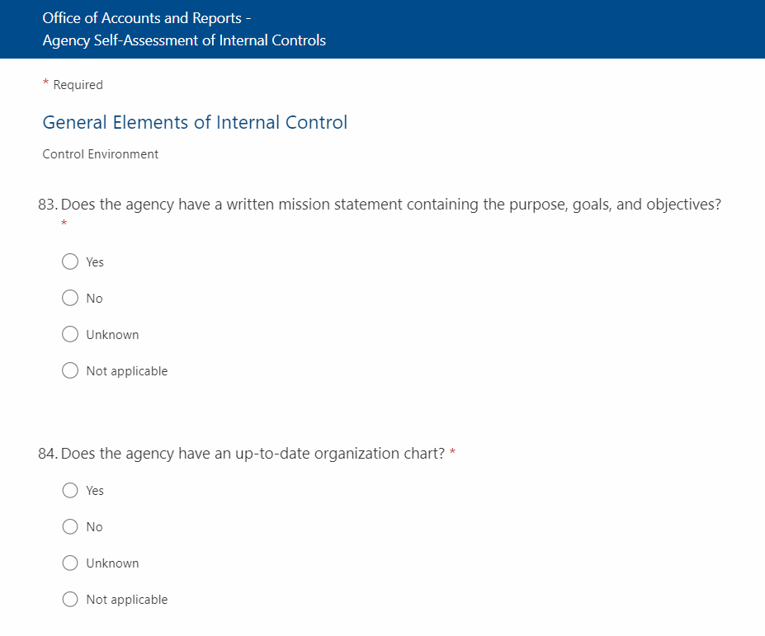
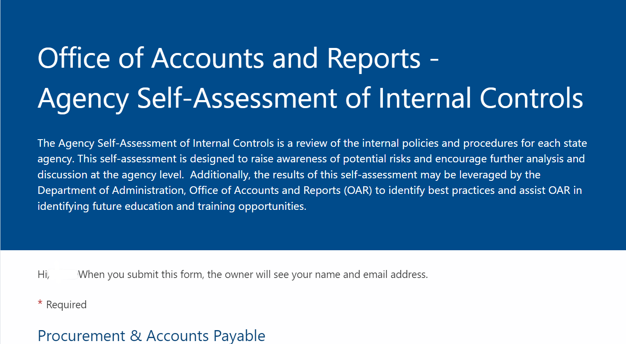
Notes:
Please view this in the presentation mode.

Slide 22
When will this be due?
Where is this
to be completed?
November 1, 2022
Microsoft Forms

Slide 23
?
?
?
?
?
?
?
Questions?
?
?
?
?
?
?
?
?
?

Slide 24
Questions?
Please contact
Internal Control and Compliance Team
OARInternal.controls@ks.gov
Notes:
Need to confirm the Internal Control Mailbox is working and the responses are being captured there.

Slide 25
Resources
Resources
The 2013 COSO Framework & SOX Compliance (coso.org)
Committee of Sponsoring Organizations of the Treadway Commission - Home (coso.org)
ESG | The Report What does the Treadway Commission have to do with COSO? (esgthereport.com)
GAO-14-704G, STANDARDS FOR INTERNAL CONTROL IN THE FEDERAL GOVERNMENT
Internal Controls Overview – YouTube
What GAO Does | U.S. GAO
State of Kansas
Internal Control & Compliance
Statewide Consolidated Reporting, Controls, & Collections Team

